Slide 1

Prediction of Pima Indians Diabetes with Machine Learning Algorithms
Presented by: Antara Saha

Slide 2



Agenda
Exploring and analyzing the Pima Indians Diabetes Dataset and using applied Machine Learning Techniques to predict the chances of being diabetic based on various other symptoms.

Slide 3




Introduction
Diabetes mellitus is a chronic disease that occurs when one’s pancreas no longer able to produce enough insulin. The long-term hyperglycemia during diabetes causes chronic damage and dysfunction of various tissues, especially the eyes, kidneys, heart, blood vessels, and nerves. Nowadays, diabetes is a major public health challenge and a worldwide problem. This study will introduce how to use medical data to analyze the relation between medical indexes and diabetes with machine learning tools. It may be helpful to doctors as a screening tool.

Slide 4

Data
The Pima Indian Diabetes Dataset, originally from the National Institute of Diabetes and Digestive and Kidney Diseases, contains information of 768 women from a population near Phoenix, Arizona, USA. The outcome tested was Diabetes, 258 tested positive and 500 tested negative. Therefore, there is one target (dependent) variable and the 8 attributes (TYNECKI, 2018): pregnancies, OGTT(Oral Glucose Tolerance Test), blood pressure, skin thickness, insulin, BMI(Body Mass Index), age, pedigree diabetes function.

Slide 5
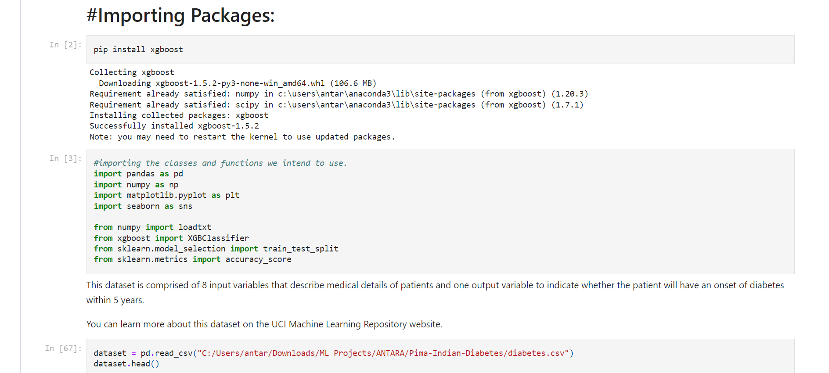
Let’s import the required libraries and dataset

Slide 6
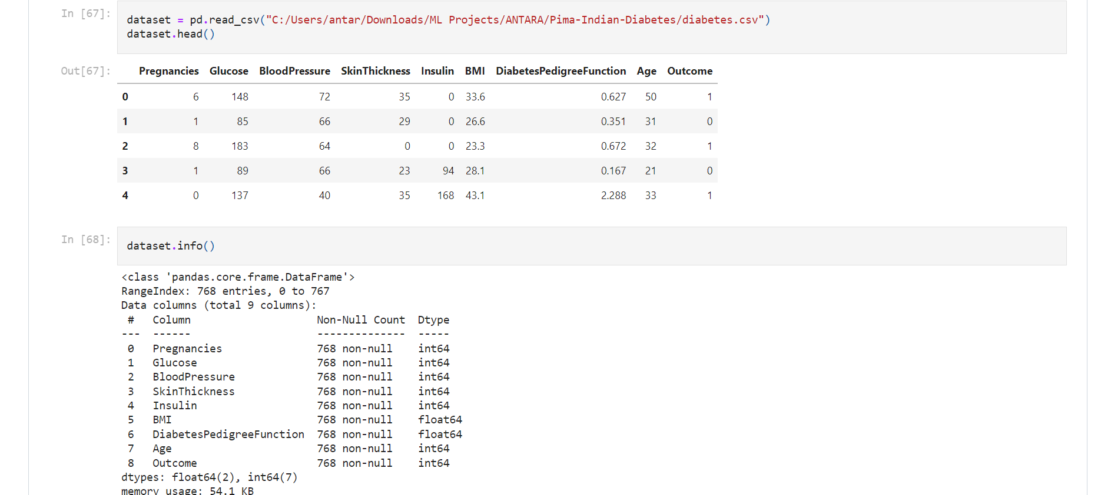
Dataset

Slide 7
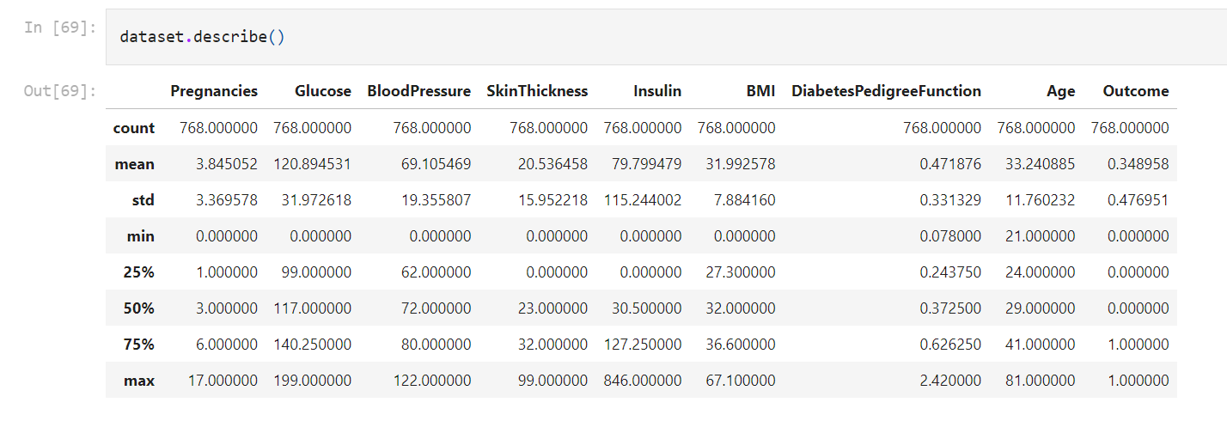

Slide 8
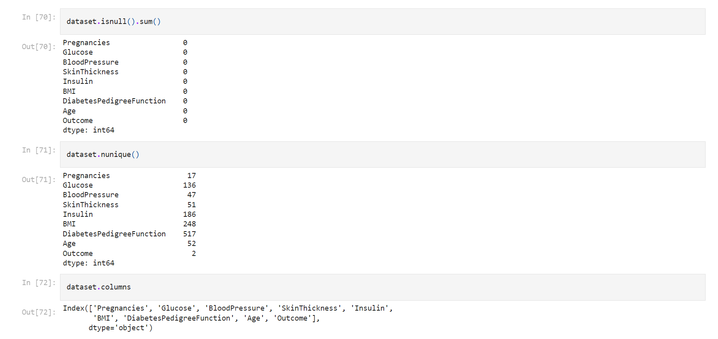
Exploratory Data Analysis

Slide 9
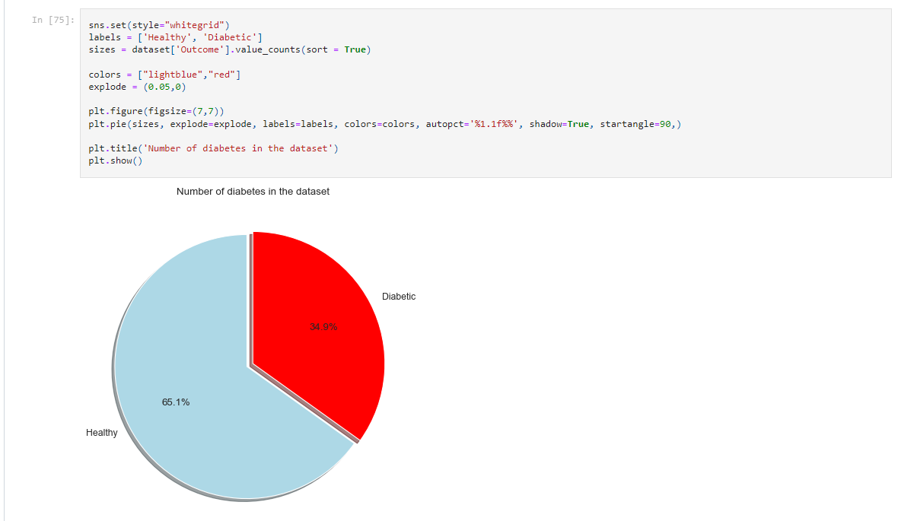
Data Visualization and Identifying Patterns

Slide 10
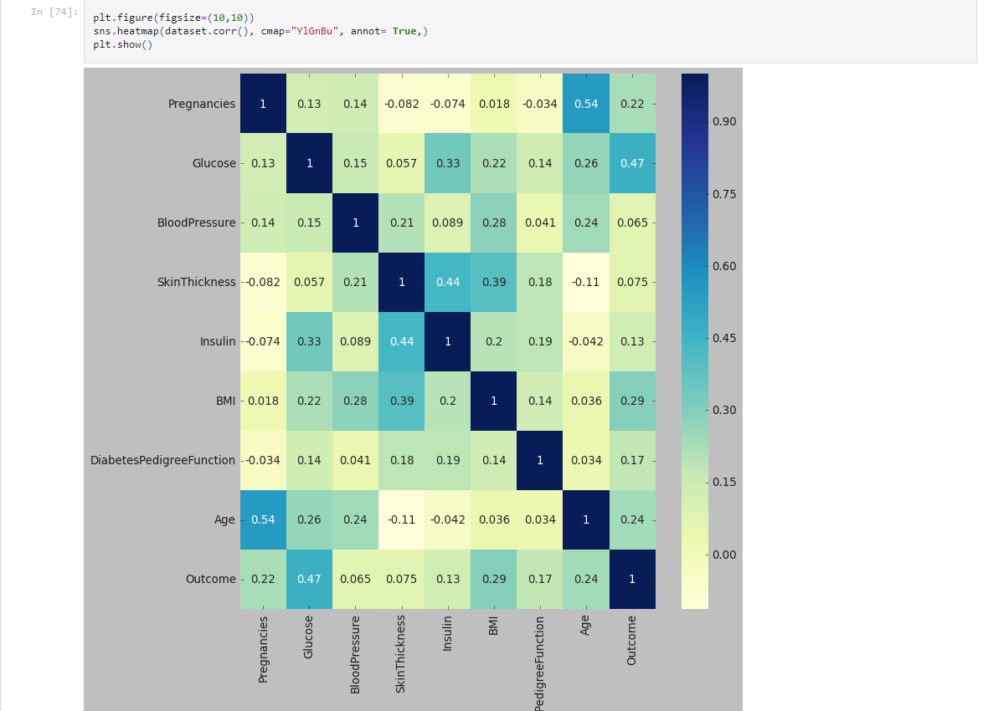
Variable Correlation

Slide 11
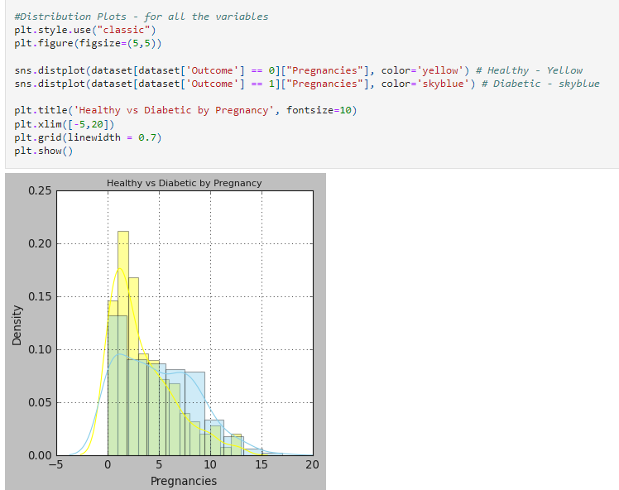
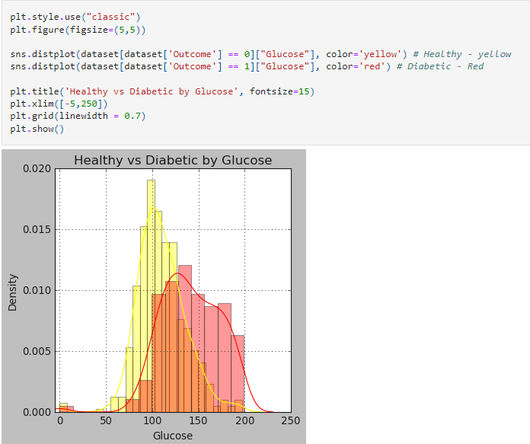
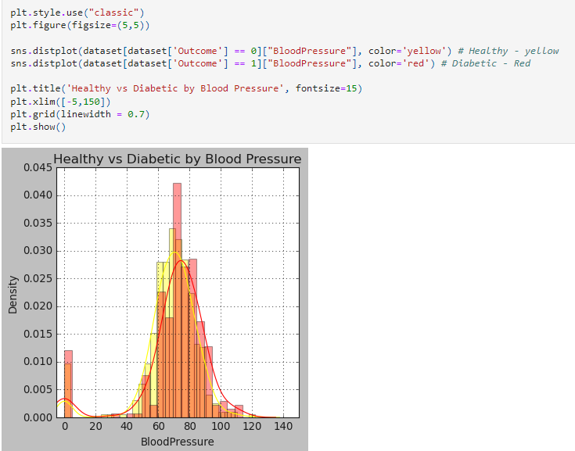
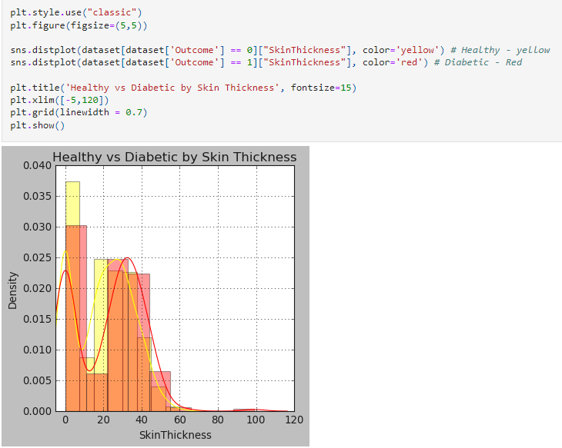
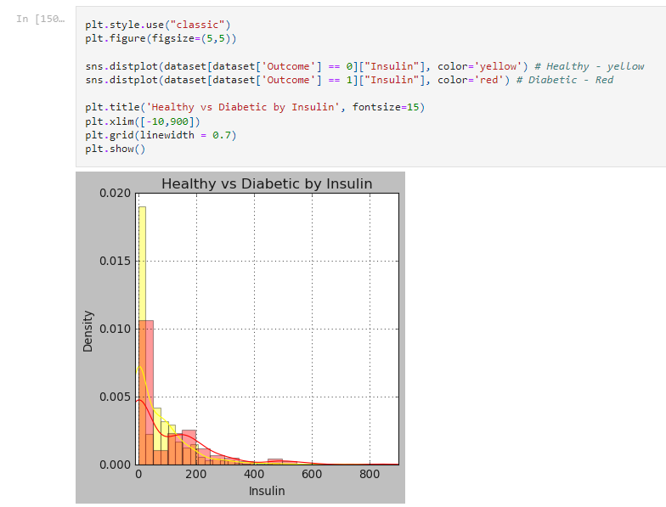
Comparing how different variables can be correlated with the diabetes by creating individual graphical representation for each variable

Slide 12
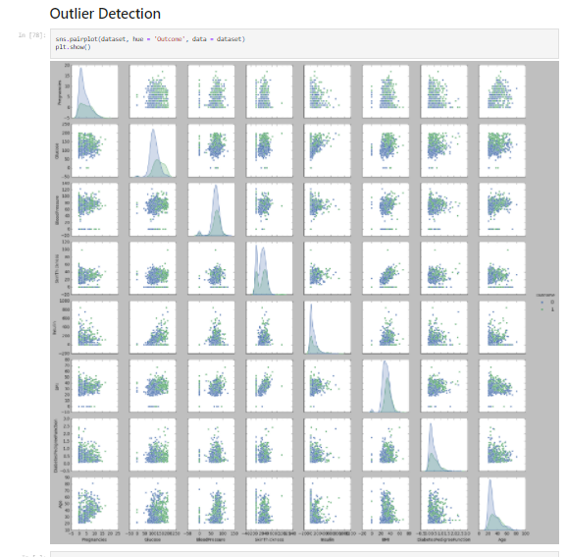
Outlier Detection

Slide 13
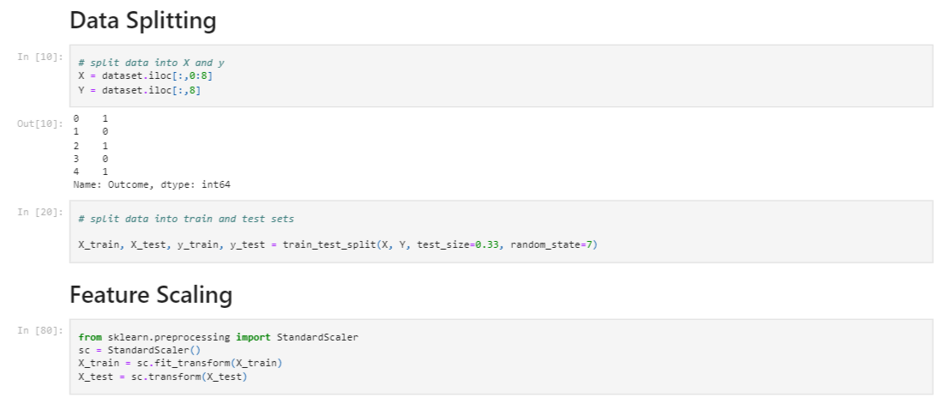
Data Preprocessing, Data Splitting and Feature Scaling

Slide 14
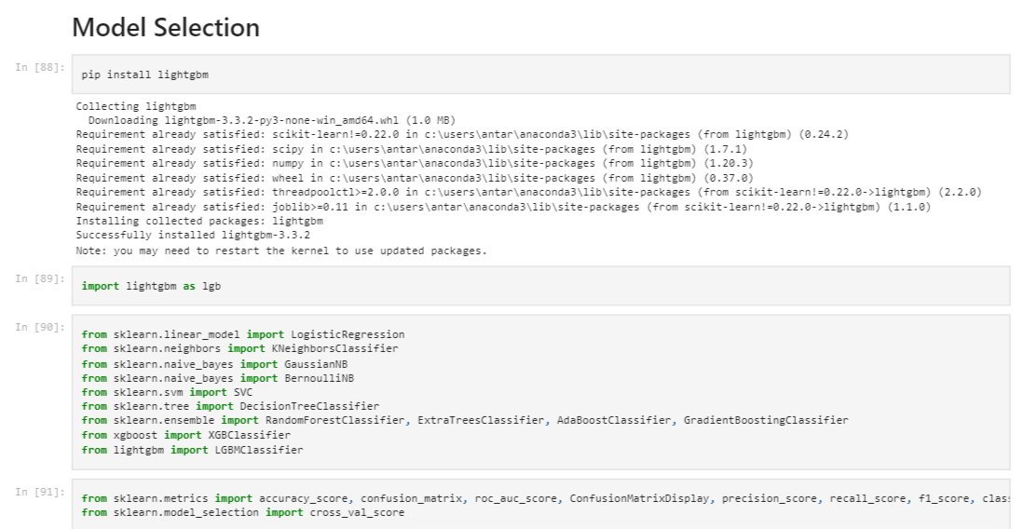
Importing libraries to perform different ML Algorithms

Slide 15
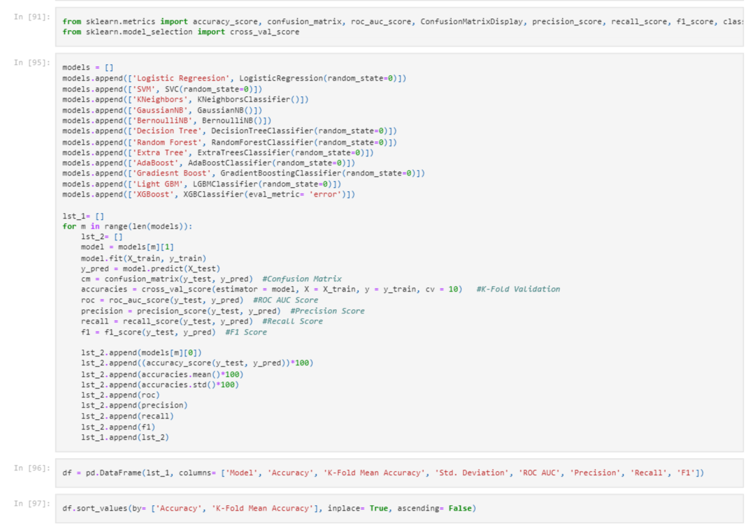
From sklearn library we are performing different classification algorithms

Slide 16
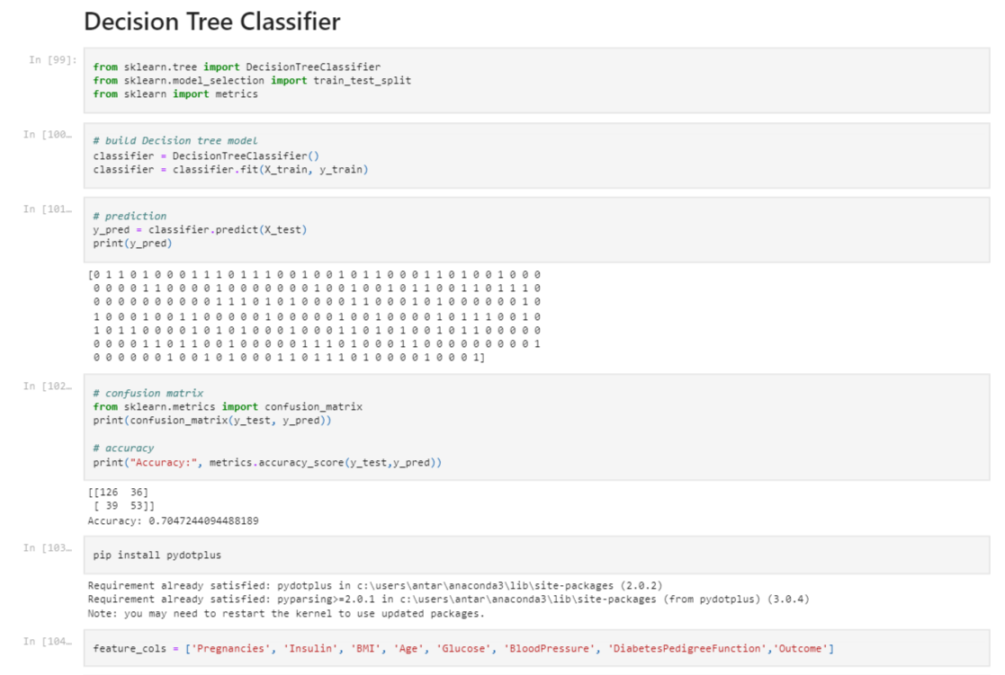
Let’s dive deep into decision tree classifier

Slide 17
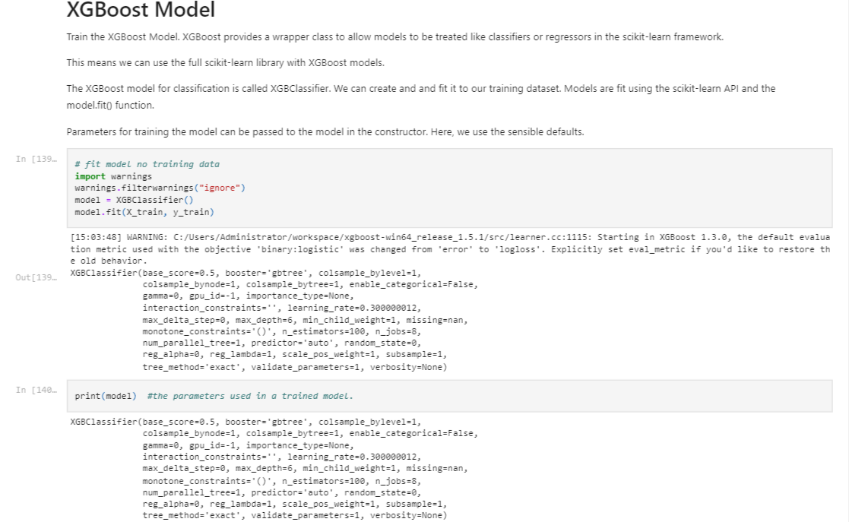
XGBoost Model

Slide 18
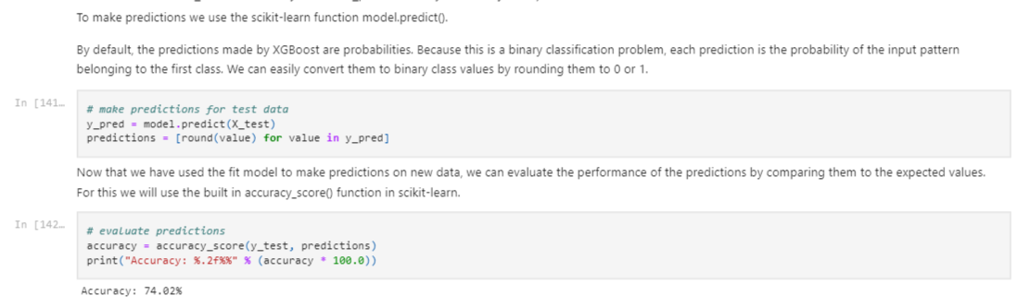
XGBoost Prediction and Accuracy

Slide 19
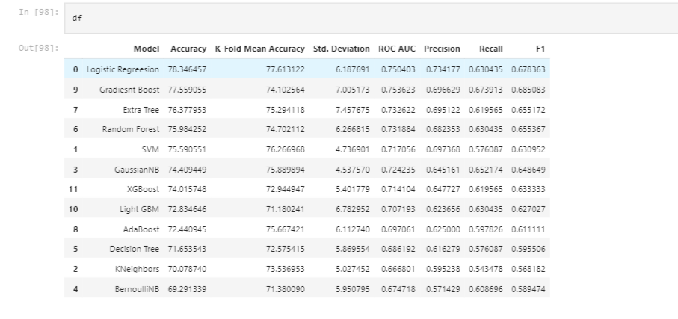
Comparing accuracy, recall, precision and other performance matrices

Slide 20

Summary
There are 12 different modeling approaches we have tried to be implemented for this case. The performance scores of each model has been showed in the previous slide. According to the table, logistic regression model has the highest accuracy score of 78.34%, the highest precision of 0.73. Followed by Gradient Boost with accuracy score of 77.56%.

Slide 21


Thank You
Antara Saha
Email: antara.saha@utdallas.edu
antarasaha.1104@gmail.com
Phone number: 469-943-4752
Website address: https://tinyurl.com/mw43kfj4

